Slide 1
CONSUMER DECISION MAKING AND MOTIVATION
MODULE -2

Slide 2
CONSUMER DECISION MAKING
Process by which consumer identify their needs, collect information, evaluate alternatives and make purchase decision.
These actions are determined by psychological and economical factors, and are influenced by environmental factors such as culture, group, and social values.

Slide 3
LEVELS OF CONSUMER DECISION MAKING
Extensive problem solving
Limited problem solving
Routinized response behaviour

Slide 4
CONSUMER INVOLVEMENT
LESS INVOLVEMENT HIGH INVOLVEMENT
ROUTINE RESPONSE BEHAVIOUR
LIMITED DECISION MAKING
EXTENSIVE DECISION MAKING

Slide 5

ROUTINE RESPONSE BEHAVIOUR
LITTLE INVOLVEMENT IN SELECTION PROCESS
MAY STICK WITH ONE BRAND
QUICK DECISION
FREQUENTLY PURCHASE LOW COST GOODS
EXAMPLES ARE SOAP , SHAMPOO ETC

Slide 6

LIMITED DECISION MAKING
MODERATE INVOLVEMENT IN SELECTION PROCESS
PURCHASING PROCESS IS SHORTER
EVALUATION OF FEW ALTERNATIVE BRANDS
EXAMPLES ARE CLOTHING, COSMETICS

Slide 7
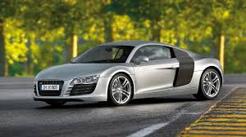
EXTENSIVE DECISION MAKING
HIGH LEVEL OF INVOLVEMENT
HIGH COST GOODS
LONG TIME TO DECIDE
EVALUATION OF MANY BRANDS
EXAMPLES ARE BUYING JEWELLERY, HOUSE
LAPTOP, CAR ETC

Slide 8
A MODEL OF CONSUMER DECISION MAKING

Slide 9
WHAT ARE CONSUMER MODELS?
The consumer models refer to varying orientations and perspectives with which consumers approach the marketplace
How/why they behave as they do.
They refer to how the varying orientations impact the buying decision process and overall buyer behaviour.

Slide 10
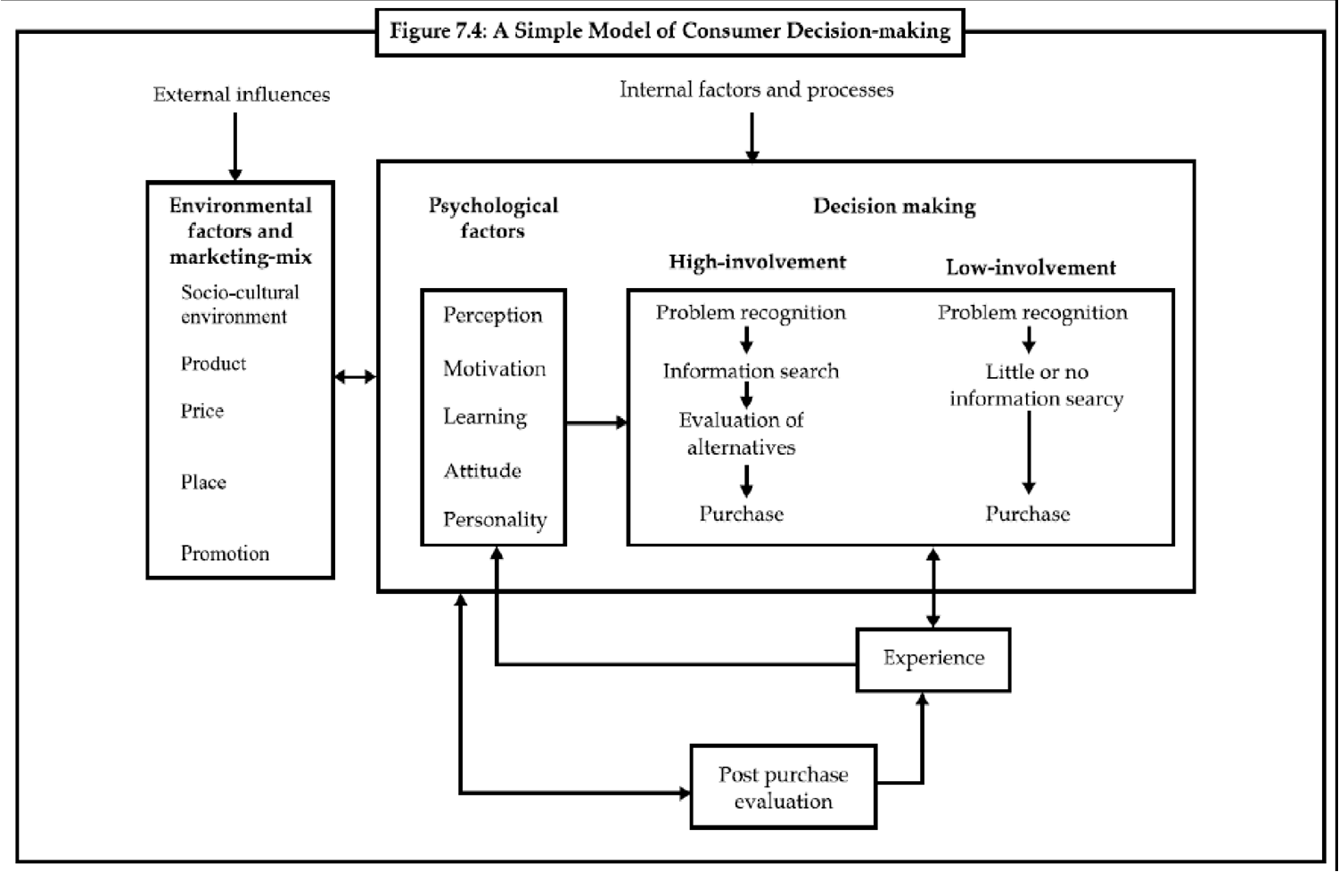

Slide 11
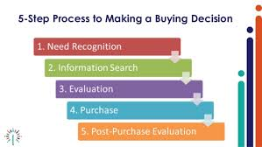
CONSUMER DECISION MAKING PROCESS

Slide 12
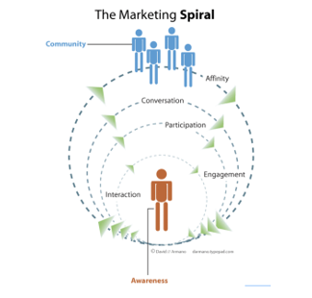

Slide 13
CONSUMER BEHAVIOUR MODELS
PAVLOVIAN MODEL
ECONOMIC MODEL
SOCIOLOGICAL MODEL
FAMILY DECISION MAKING MODEL

Slide 14
OTHER CONSUMER DECISION MAKING MODELS
THE FIVE VALUES INFLUENCING CONSUMER CHOICE BEHAVIOR
SOLOMON MODEL OF COMPARISON PROCESS
HOWARD-SHETH MODEL
ENGEL-KOLLAT-BLACKWELL MODEL

Slide 15
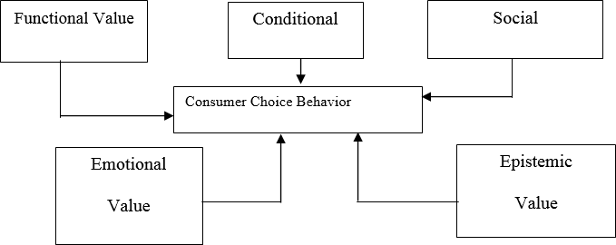
SHETH-NEWMAN GROSS MODEL OF CONSUMPTION VALUES
According to this model, there are five consumption values influencing consumer choice behavior.
These are functional, social, conditional, emotional, and epistemic values.
Any or all of the five consumption values may influence the decision.
Various disciplines (including economics, sociology, several branches of psychology, marketing and consumer behavior) have contributed theories and research findings relevant to these values, (Sheth et al. 1991).

Slide 16
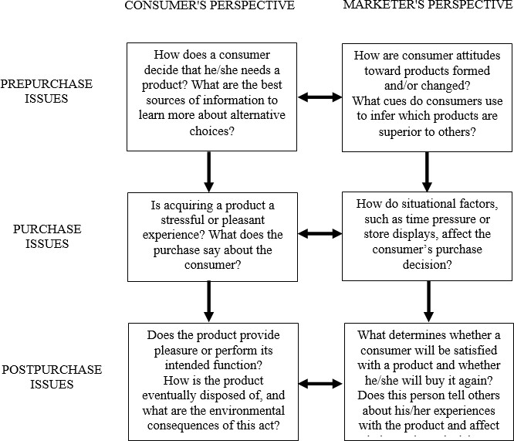
SOLOMON MODEL OF COMPARISON PROCESS

Slide 17
THEORY OF REASONED ACTION (TRA)
According to the theory, intention to perform a certain behaviour precedes the actual behaviour.
This intention is known as behavioural intention and comes as a result of a belief that performing the behaviour will lead to a specific outcome.
TRA states that a person's intention to perform a behaviour is the main predictor of whether or not they actually perform that behaviour.
Additionally, the normative component (i.e. social norms surrounding the act) also contributes to whether or not the person will actually perform the behaviour.

Slide 18
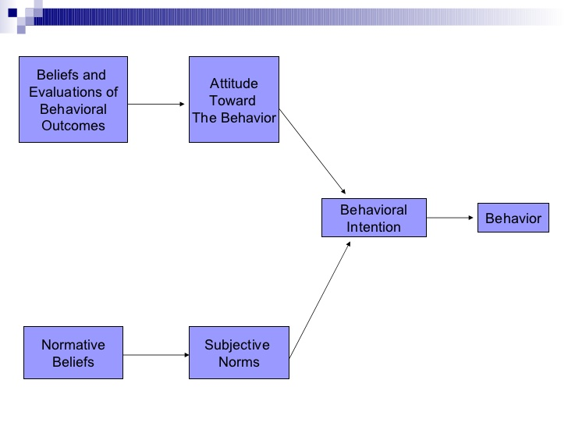

Slide 19
HOWARD-SHETH MODEL
This Model Suggests Three Levels Of Decision Making: -
The first level describes the extensive problem solving. At this level the consumer does not have any basic information or knowledge about the brand and he does not have any preferences for any product. In this situation, the consumer will seek information about all the different brands in the market before purchasing.
The second level is limited problem solving. This situation exists for consumers who have little knowledge about the market, or partial knowledge about what they want to purchase. In order to arrive at a brand preference some comparative brand information is sought.
The third level is a habitual response behavior. In this level the consumer knows very well about the different brands and he can differentiate between the different characteristics of each product, and he already decides to purchase a particular product.

Slide 20
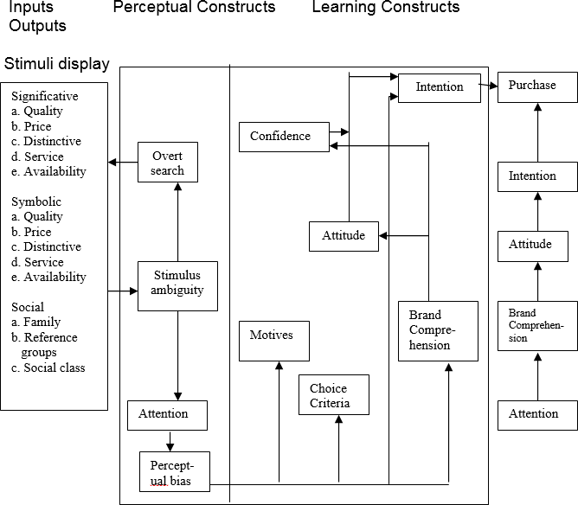

Slide 21
ENGEL-KOLLAT-BLACKWELL MODEL
This model was created to describe the increasing, fast-growing body of knowledge concerning consumer behavior. This model, like in other models, has gone through many revisions to improve its descriptive ability of the basic relationships between components and sub-components, this model consists also of four stages;
Information Input
Information Processing
Decision Process
Variables Influencing The Decision Process

Slide 22
